Slide 1

SKILL /JOB RECOMMENDER APPLICATION
PRESENTED BY THE TEAM
PNT2022TMID32271
Nandha College Of Technology
Pon Pandian P
Sekar S
Sakthisri S S
LakshmanaKumar V
Final year / Information Technology

Slide 2



PROJECT DESCRIPTION :
Having lots of skills but wondering which job will best suit you? Don’t need to worry! We have come up with a skill recommender solution through which the fresher or the skilled person can log in and find the jobs by using the search option or they can directly interact with the chatbot and get their dream job.
To develop an end-to-end web application capable of displaying the current job openings based on the user skillset. The user and their information are stored in the Database. An alert is sent when there is an opening based on the user skillset. Users will interact with the chatbot and can get the recommendations based on their skills. We can use a job search API to get the current job openings in the market which will fetch the data directly from the webpage.

Slide 3
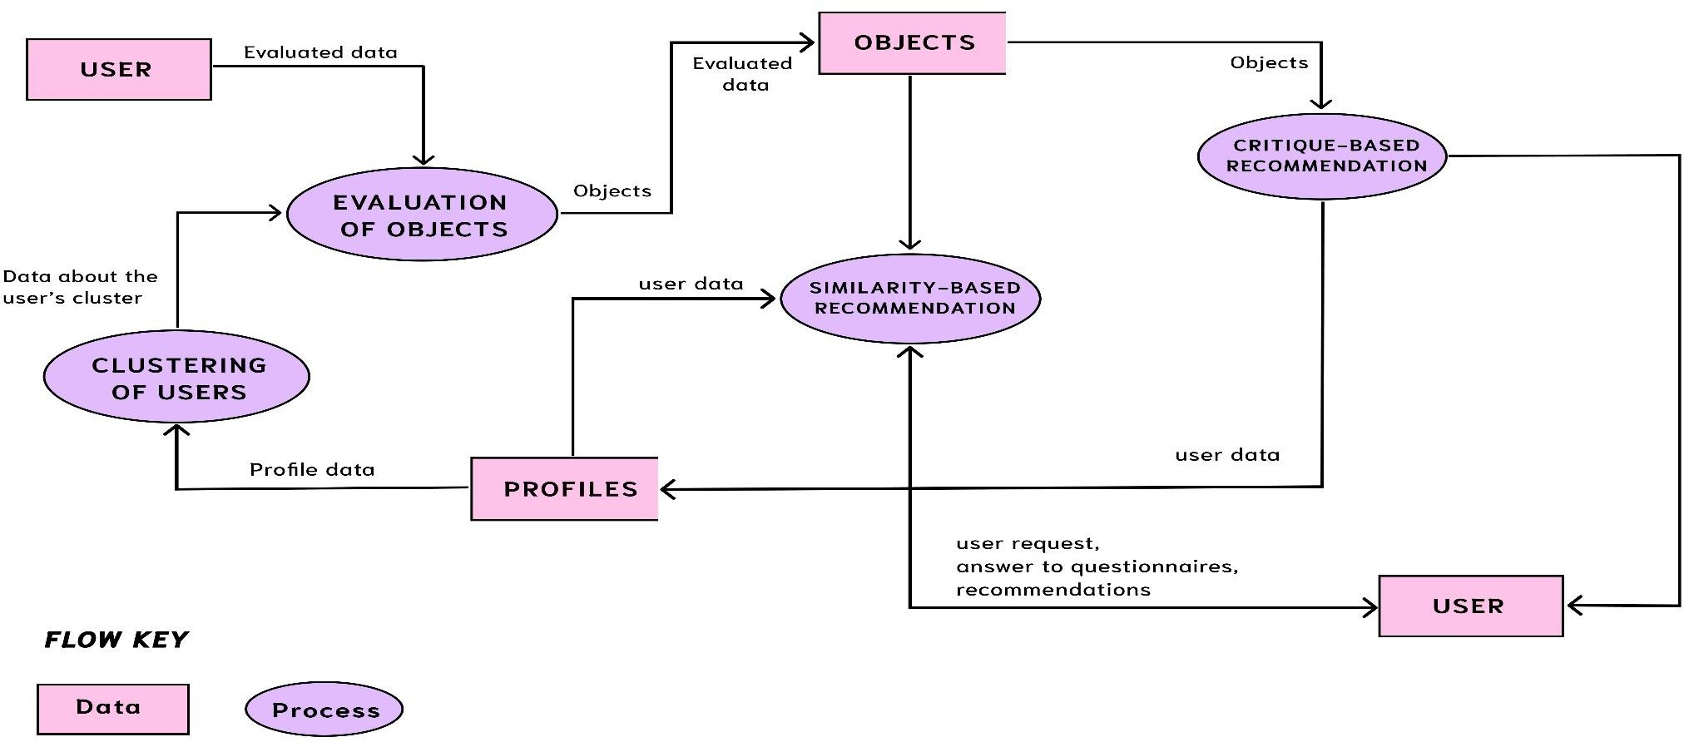
PROJECT FLOW :

Slide 4
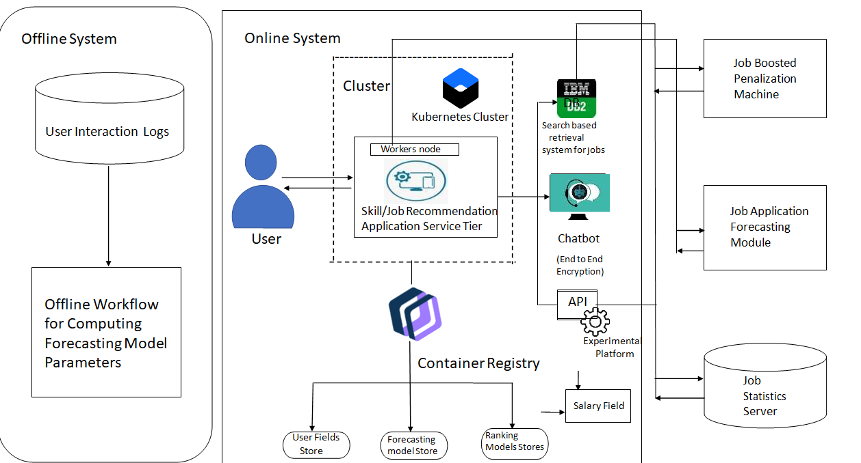
SOLUTION ARCHITECTURE :

Slide 5
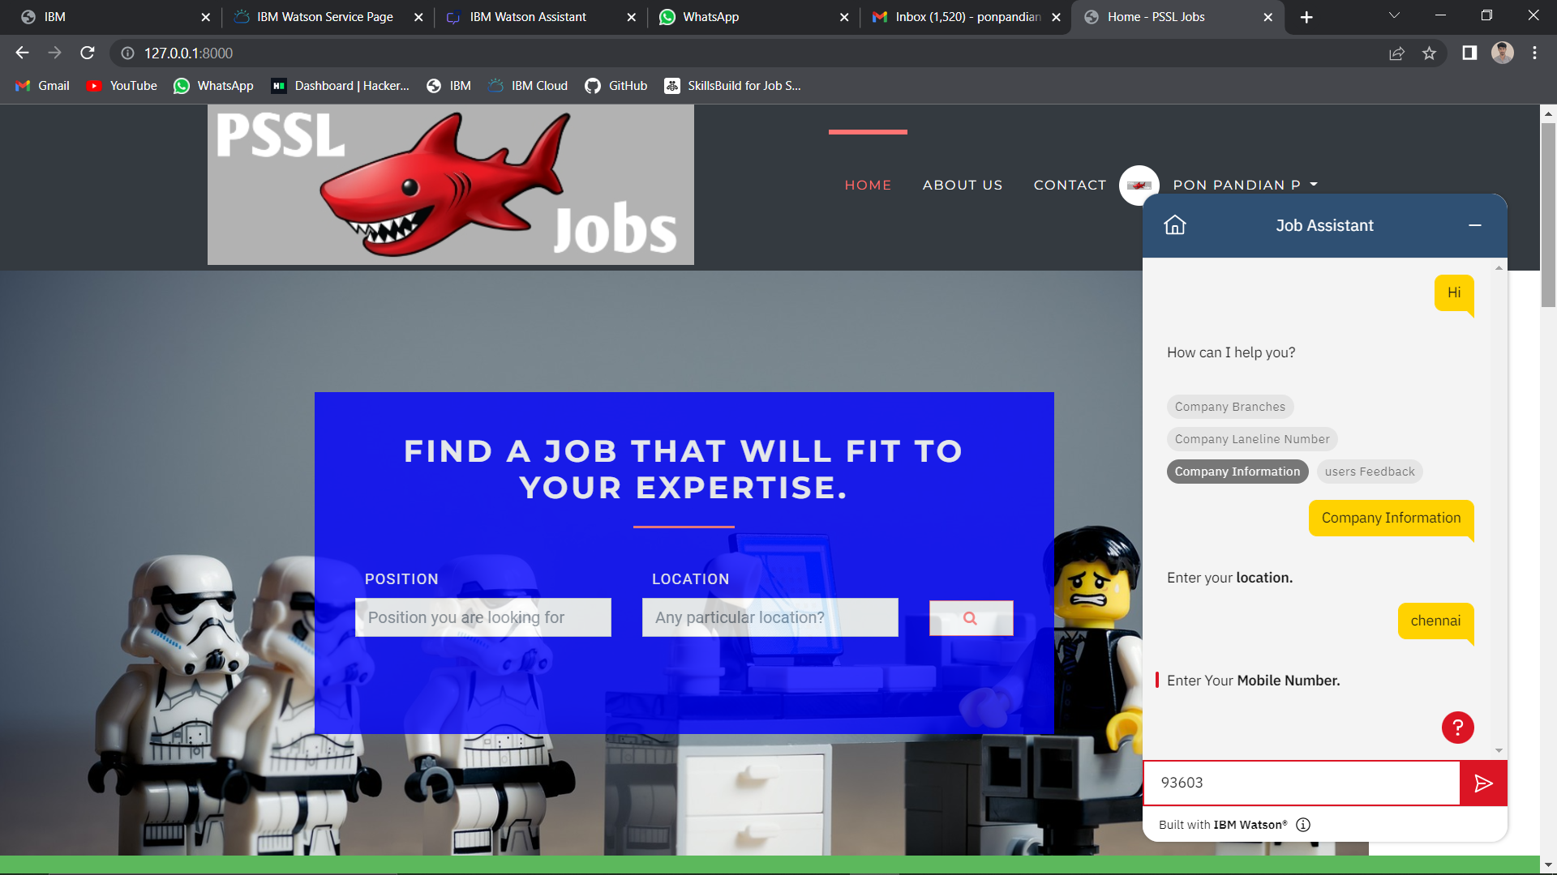
PROTOTYPE :

Slide 6


